Slide 1
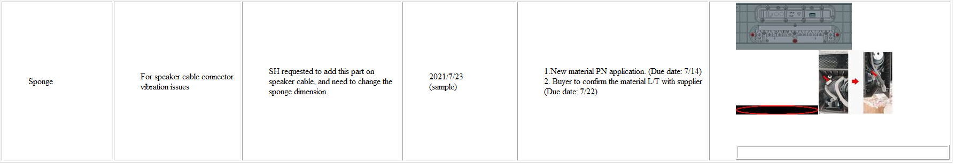
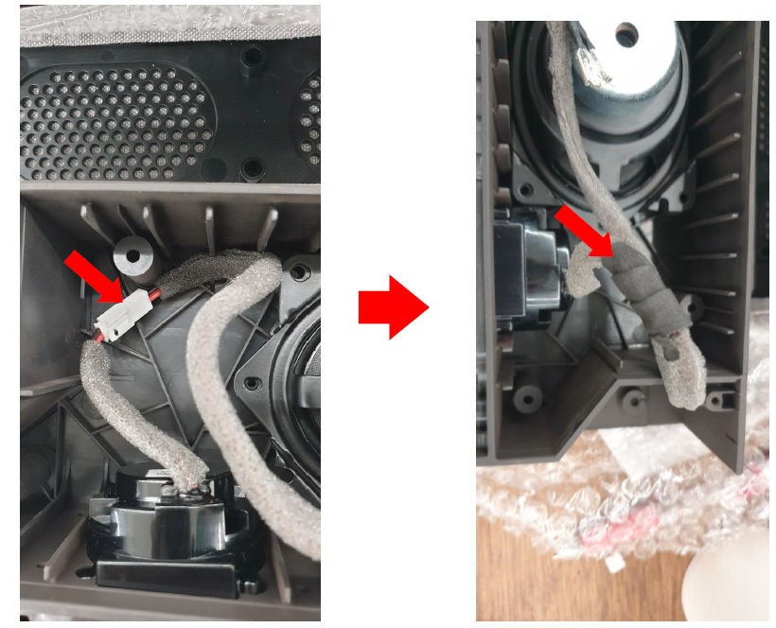
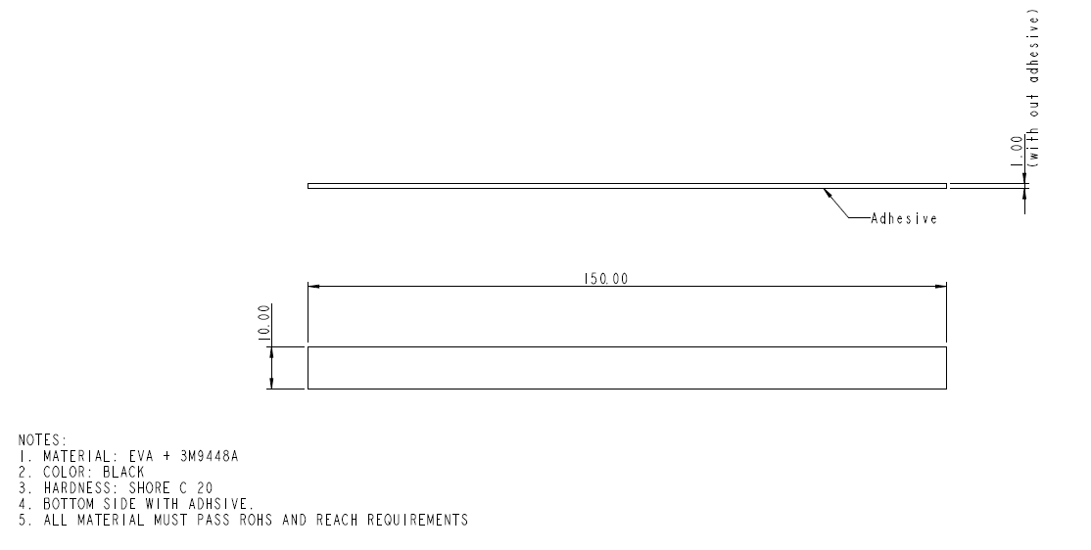
Sponge (For speaker cable connector vibration issues)
Sponge spec
The length of 484.00422.005(10x300x1mm) used in each speaker connector is 150mm (our factory need to cut it in half for each connector), So we add this sponge(10x150x1mm, Qty:2 pcs ) for MP that the factory don't need to cut for the last 0.5pcs.
[210723] ALT Feedback.
Next Monday will update to you. Need to discussion with inkel vender
Please check FII vender can supply this sponge. (10x150x1)
[210729] See next page

Slide 2
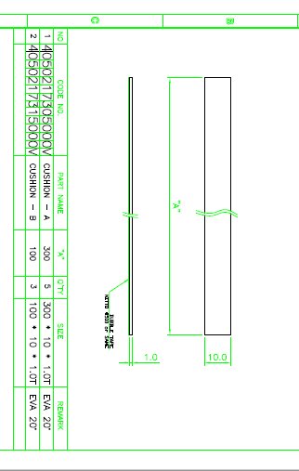
Sponge (For speaker cable connector vibration issues)
[210729] update
ALT and Inkel will add this sponge(10x150x1mm, Qty:3 pcs ) for 2nd MP
1 of 10x150x1mm : for Top cover
2, 3 of 10x150x1mm : for each Speaker connector
Please see the mantis more details 0001308: [SWAN] MP datasheet

Slide 3
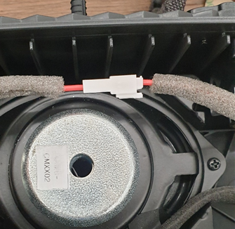
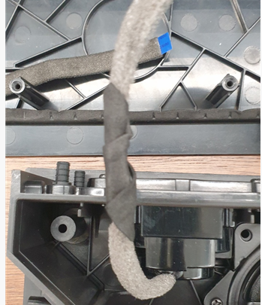
Sponge (For speaker cable connector vibration issues)
[210730] update for first MP (1k)
ALT and Inkel will more supply this sponge(55x15x1mm, Qty: 2pcs -> 4 pcs ) for 1st MP
1,2 of 55x15x1mm : for side LED bracket
3,4 of 55x15x1mm : for each Speaker connector
Don’t need to gasket cut by hand at the factory

